Slide 1
南昌大学 文学系学术答辩 PPT
Nanchang University
author / Meimei Han Time / 2024.05

Slide 2
01
T ext here
Copy pas te fonts. Choose the only option to retain text.
……
02
T ext here
Copy pas te fonts. Choose the only option to retain text.
……
03
T ext here
Copy pas te fonts. Choose the only option to retain text.
……
04
T ext here
Copy pas te fonts. Choose the only option to retain text.
……
05
T ext here
Copy pas te fonts. Choose the only option to retain text.
……

Slide 3
01
Edit Master text styles
Theme color make s PPT more convenient to change.
Adjust the spacing to adapt to Chinese typesetting, use the reference line in PPT.

Slide 4
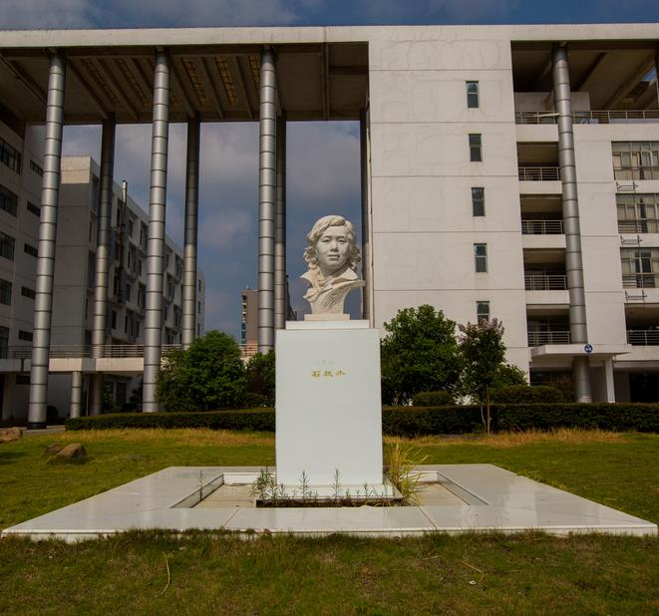
Text h ere
Sup porting text here
Text here
Sup porting text here Sup porting text here
……
Text here
Sup porting text here Sup porting text here
……

Slide 5
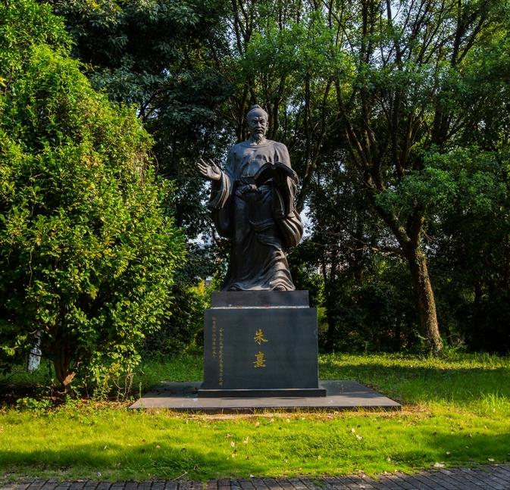
Suppo rting text here.
Unified fonts m ake
reading more fluent.
Theme color makes PPT more convenient to change.Adj ust
the spacing to adapt to Chinese typesetting, use the reference
line in PPT.
Text here
48%
77%
Text here
40%
90%

Slide 6
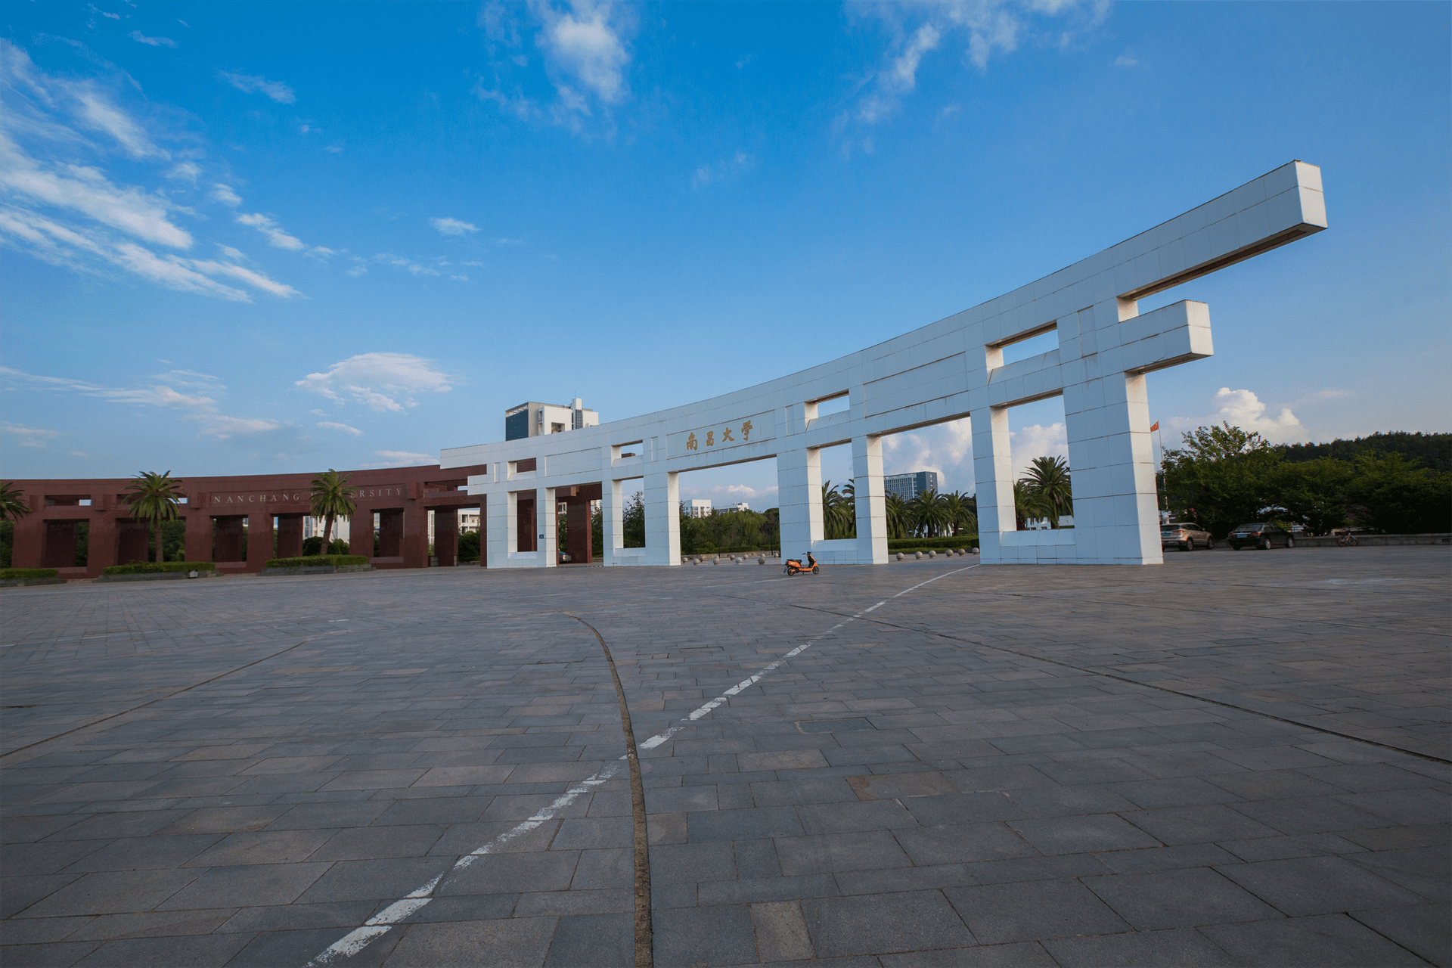
Unified fonts make r eading
more fluent.
Theme color makes PPT more convenient to change.
Adjust the spacing to adapt to Chinese typesetting, use the ref erence line in PPT…… Adjust the spacing to adapt to Chinese typesetting, use the reference line in PPT……

Slide 7
Text here
Text here
Text here
Copy paste fonts. Choose the only o ption to retain text.
……
Copy paste fonts. Choose the only o ption to retain text.
……
Copy paste fonts. Choose the only o ption to retain text.
……
Copy paste fonts. Choose the only o ption to retain text.
……
Copy paste fonts. Choose the only o ption to retain text.
……
Copy paste fonts. Choose the only o ption to retain text.
……

Slide 8
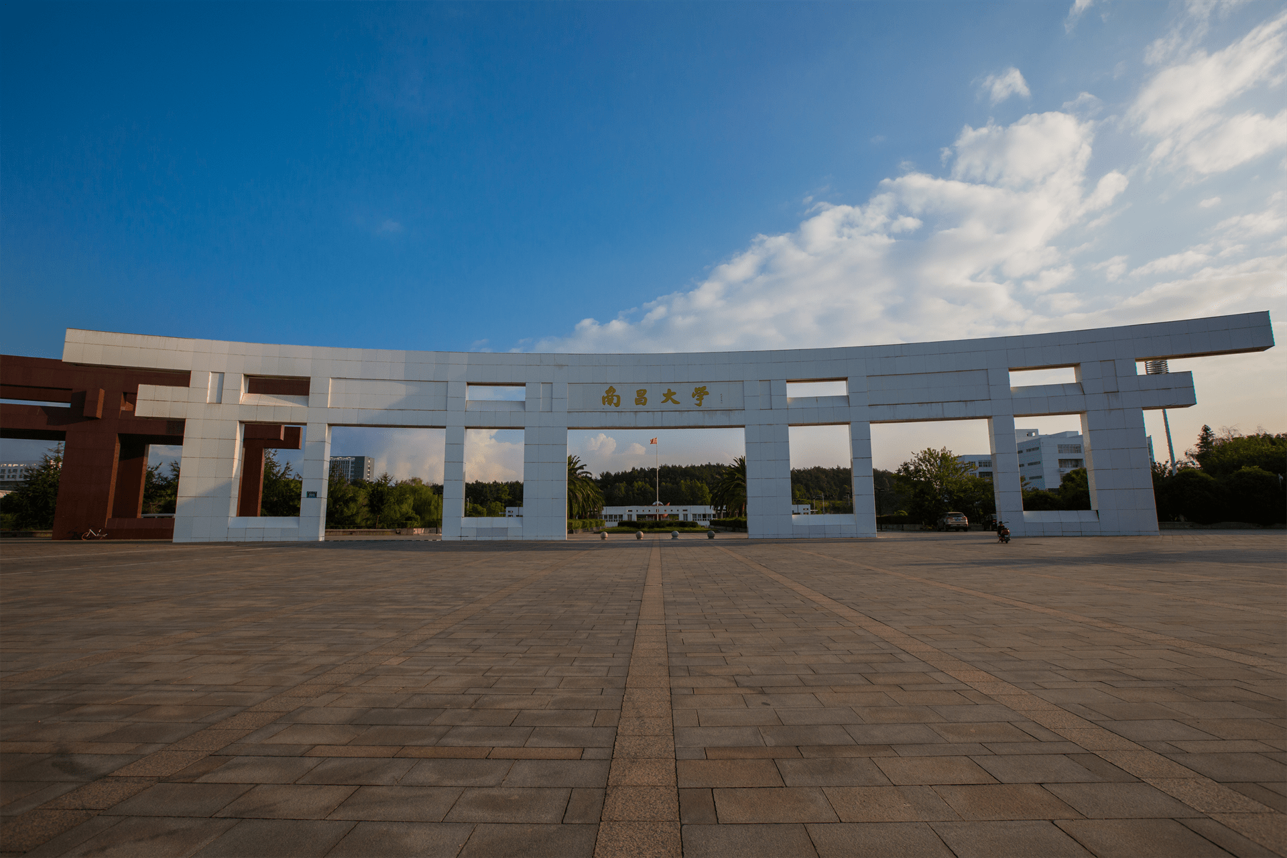
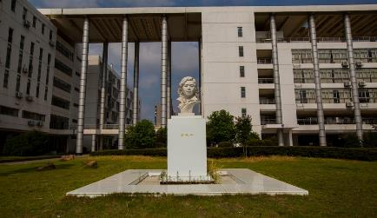
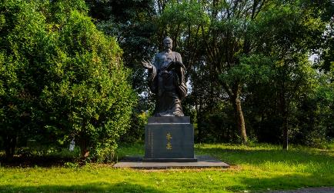
Text here
Copy paste fonts. Choose the only option to retain text……
Text here
Text here
Text here
Text here
… Text
… Text
77%
42%
58%
17%
60%
90%
35%
71%
Sup porting text here.
……
Sup porting text here.
……
… Text
… Text
Sup porting text here.
……
Sup porting text here.
……

Slide 9
Unified fonts make r eading more fluent.
Supporting text he re.
Theme color makes PPT more convenient to change.
Adjust the spacing to adapt to Chinese typesetting, use the referen ce line in PPT.

Slide 10
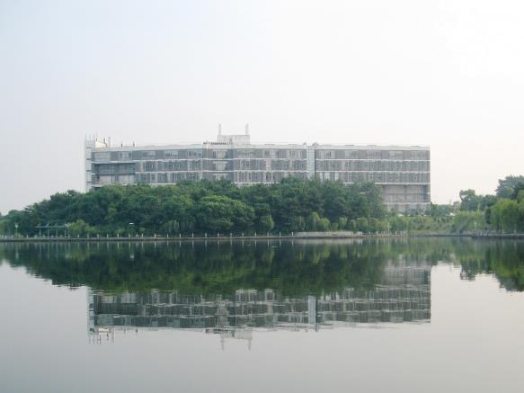
Theme color makes PPT more convenient to change.
Adjust the spacing to adapt to Chinese typesetti ng, use the reference line in PPT……

Slide 11
Unified fonts
make reading m ore fluent.
Theme color makes PPT more convenient to change.
Adjust the spacing to adapt to Chinese typesetti ng, use the reference line in PPT……
Theme color ma kes PPT more convenient to change.
Adjust the spacing to adapt to Chinese typesetting, use the reference line in PPT……

Slide 12
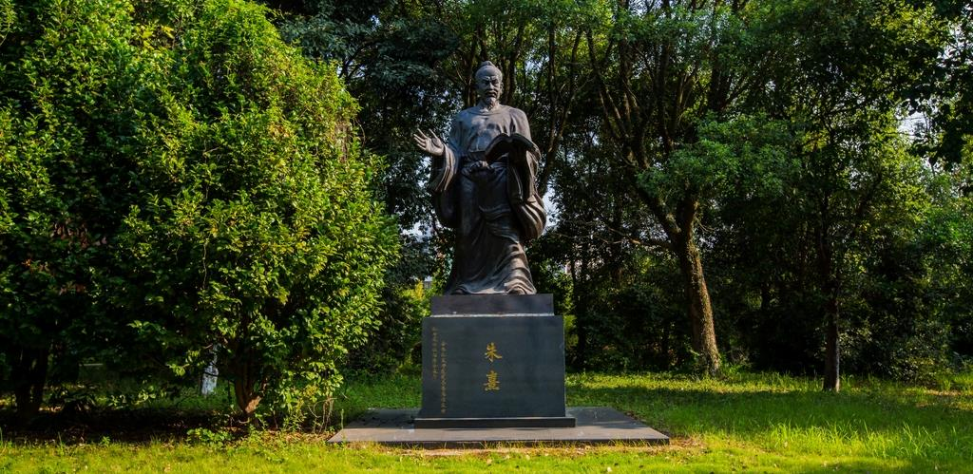
Supporting text h ere.
Unified Fonts Make Reading More Fluent.
Text h ere
Copy paste fonts. Choose the only option to retain text.
… …

Slide 13
T ext here
Unified font s make reading
more fluent.
Copy pas te fonts. Choose the only option to retain text……
T ext here
Theme color makes PPT more convenient t o change.
Adjust the spacing to adapt to Chinese typesetting, use the reference line in PPT……
Copy pas te fonts. Choose the only option to retain text……
T ext here
Copy pas te fonts. Choose the only option to retain text……

Slide 14
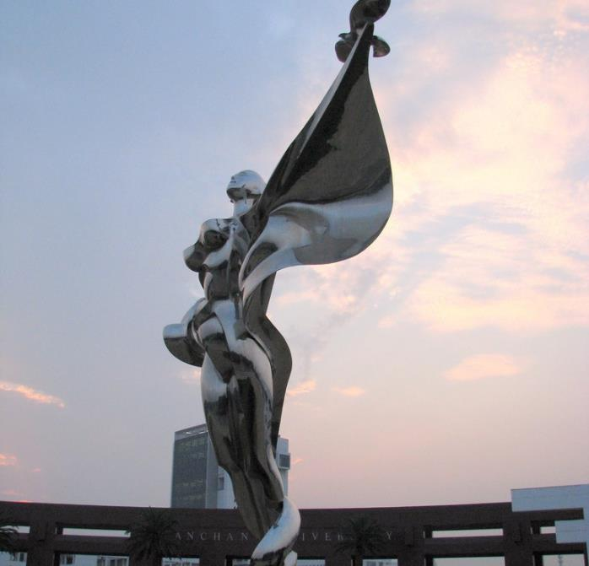
Supporting text her e.
Unified fonts make
reading more fluen t.
Theme color makes PPT more convenient to change.Adjust
the spacing to adapt to Chinese typesetting, use the reference
line in PPT.
Text here
Text here
Text here

Slide 15
Text h ere
Theme color make s PPT more convenient to change.
Adjust the spacing to adapt to Chinese typesetting, use the reference line in PPT.
Theme color make s PPT more convenient to change.
Adjust the spacing to adapt to Chinese typesetting, use the reference line in PPT.
Sup porting text here

Slide 16
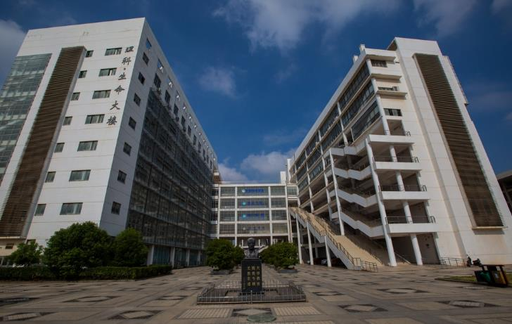
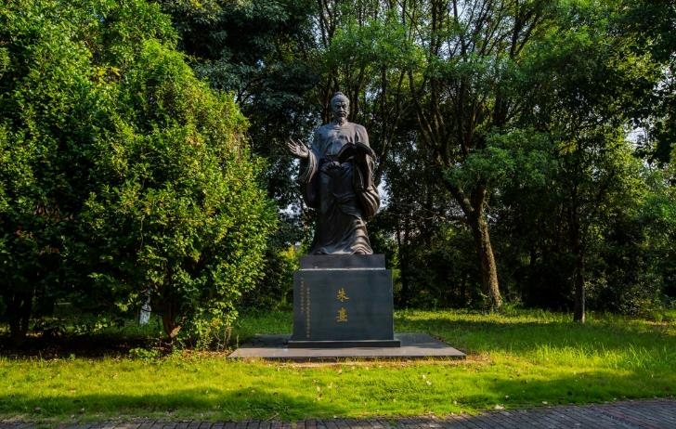
Text h ere
Sup porting text here
Theme color make s PPT more convenient to change.
Adjust the spacing to adapt to Chinese typesetting, use the reference line in PPT.
Theme color make s PPT more convenient to change.
Adjust the spacing to adapt to Chinese typesetting, use the reference line in PPT.

Slide 17
Text here
Text here
Text here
Sup porting text here
Sup porting text here
……
Sup porting text here
Sup porting text here
……
Sup porting text here
Sup porting text here
……

Slide 18
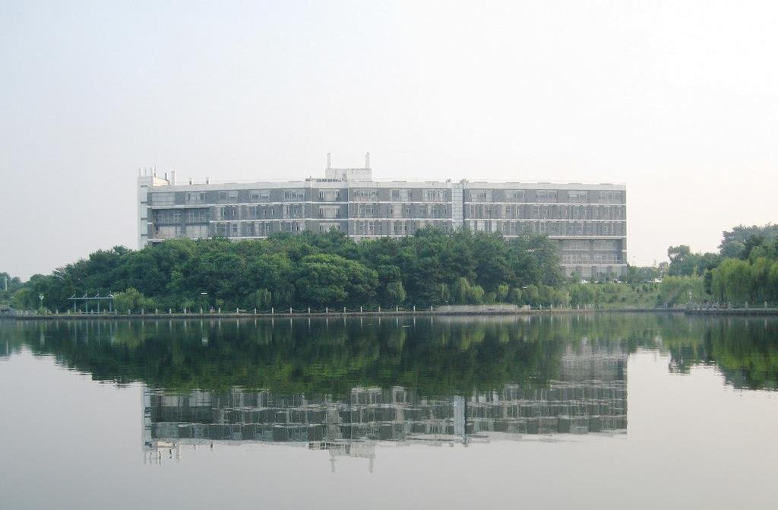
Text here
Sup porting text here
Text here
Theme color make s PPT more convenient to change.
Adjust the spacing to adapt to Chinese typesetting, use the reference line in PPT.
Text here
Theme color make s PPT more convenient to change.
Adjust the spacing to adapt to Chinese typesetting, use the reference line in PPT.

Slide 19
Text here
Theme color make s PPT more convenient to change.
Adjust the spacing to adapt to Chinese typesetting, use the reference line in PPT.
Sup porting text here
78%
66%
69%
52%
44%
Text here
Text here
Text here
Text here
Text here

Slide 20
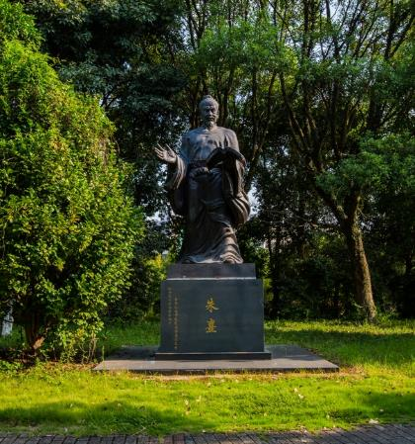
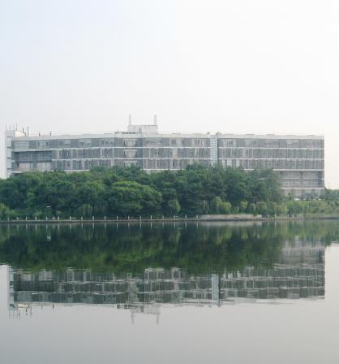
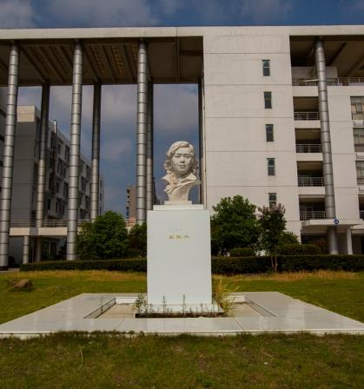
Text here
Text here
Sup porting text here
Text here
Sup porting text here
Text here
Sup porting text here
Text here
Sup porting text here
Text here
Text here
Text here
Text here
Sup porting text here Sup porting
text here
……
Sup porting text here Sup porting
text here
……
Sup porting text here Sup porting
text here
……
Sup porting text here Sup porting
text here
……

Slide 21
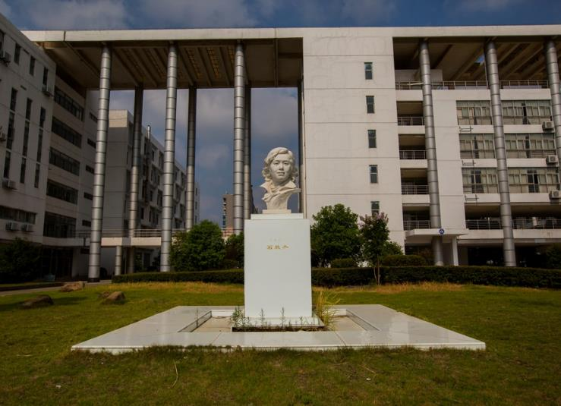
Text here
Theme color makes PPT more convenient to change.
Adjust the spacing to adapt to Chinese typesetting, use the reference line in PPT……

Slide 22
0 1
0 2
0 3
0 4
Text here
Text here
Text here
Text here
Supporting text here.
… …
Supporting text here.
… …
Supporting text here.
… …
Supporting text here.
… …

Slide 23
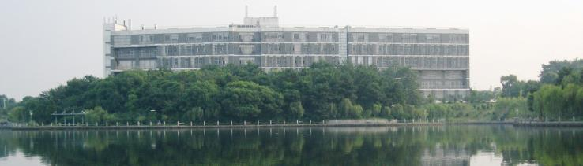
Supp orting text here.
Text Here
Unified fonts make reading more fluent.
Copy paste fonts. Choose the only option to retain text.
……
Text Here
Theme color makes PPT more conveni ent to change.
Adjust the spacing to adapt to Chinese typesetting, use the reference line in PPT.
Theme color makes PPT more convenient to change.
… …
Copy paste fonts. Choose the only option to retain text.
……
Text Here
Copy paste fonts. Choose the only option to retain text.
……
Text Here
Copy paste fonts. Choose the only option to retain text.
……

Slide 24
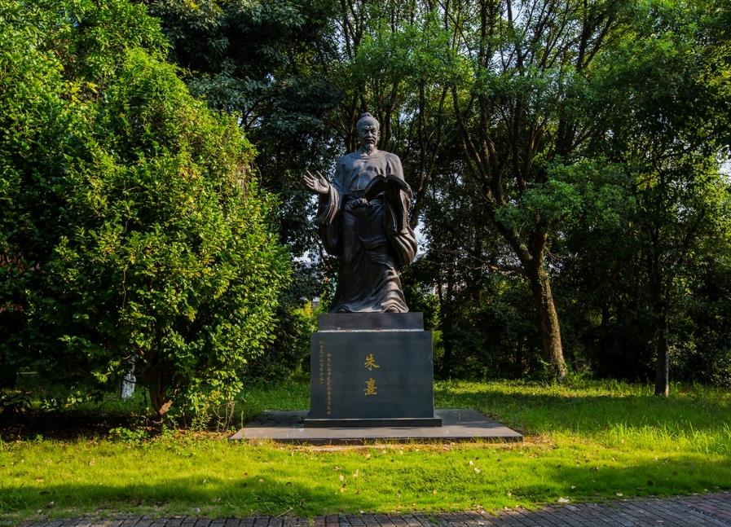
Unified fonts make reading more fluent.
Theme color makes PPT more convenient to change .
Adjust the spacing to adapt to Chinesetypesetting, use the reference line in PPT.
Text here
Text here
Text here

Slide 25

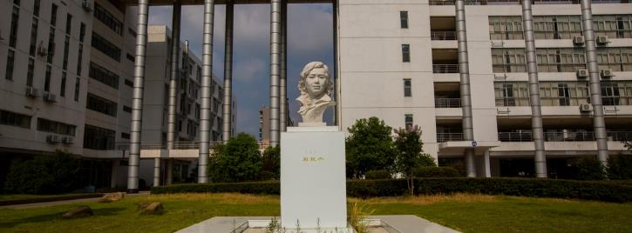
71%
Text here
Supporting text here

Slide 26
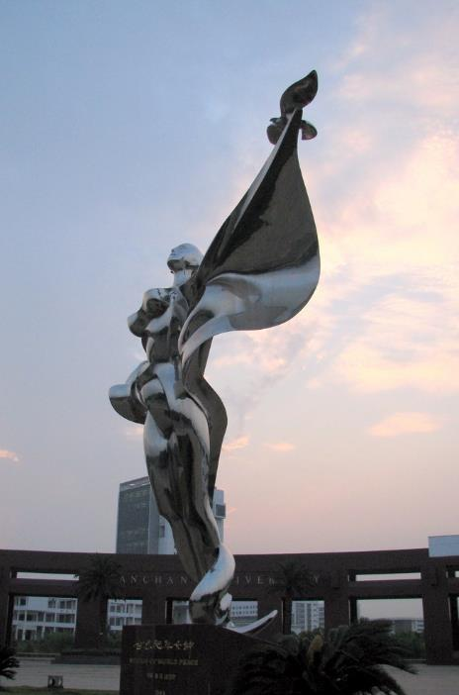
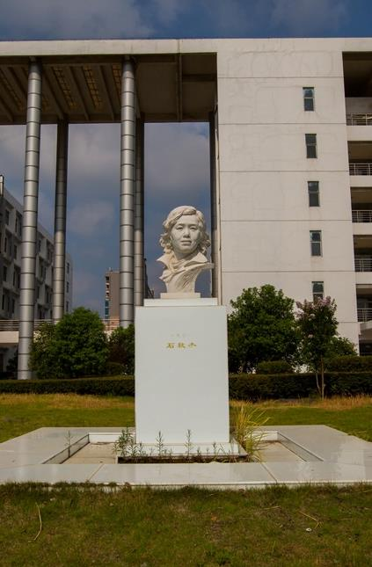
Unified
fon ts make
reading more fluent.
Theme color makes PPT more convenient to change.Adjust the spacing to adapt to Chinese typesetting, use the reference line in PPT.
… …

Slide 27
Text h ere
Sup porting text here
Sup porting text here
Sup porting text here
……
Theme color make s PPT more convenient to change.
Adjust the spacing to adapt to Chinese typesetting, use the reference line in PPT.

Slide 28
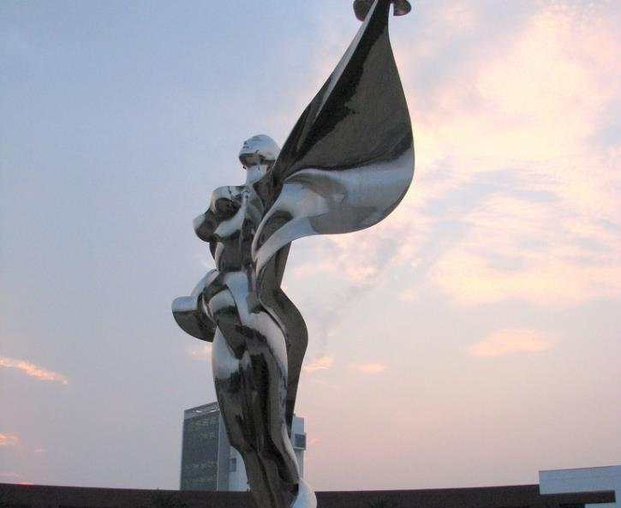
Text here
Theme color make s PPT more convenient to change.
Adjust the spacing to adapt to Chinese typesetting, use the reference line in PPT.
Text here
Theme color make s PPT more convenient to change.
Adjust the spacing to adapt to Chinese typesetting, use the reference line in PPT.

Slide 29
THANKS
Nanchang University
-

